Slide 1
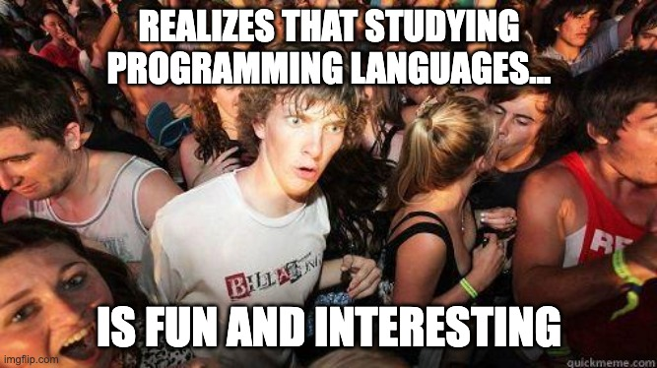
CS131: Programming Languages
Fall 2023
Carey Nachenberg
climberkip@gmail.com; ENG VI 299

Slide 2




Useful Information
Carey's
Mon: 4-5pm, Wed: 1-2pm
Location: Eng VI 364
Our Class Hub
https://bruinlearn.ucla.edu/courses/168646
Syllabus, Assignments, PPTs, Lectures Notes, Solutions
https://ucla-cs-131.github.io/fall-23-website
Your Questions – Our Answers
https://campuswire.com/p/G8DA58F59
Verification Code: 5216

Slide 3





Meet Our Team
Carey Nachenberg
Andrey Storozhenko
Discussions 1D and 1G
Bonnie Liu
Discussions 1B and 1H
Brian Wang
Discussions 1C and 1F
Justin Cui
Discussions 1A and 1E

Slide 4
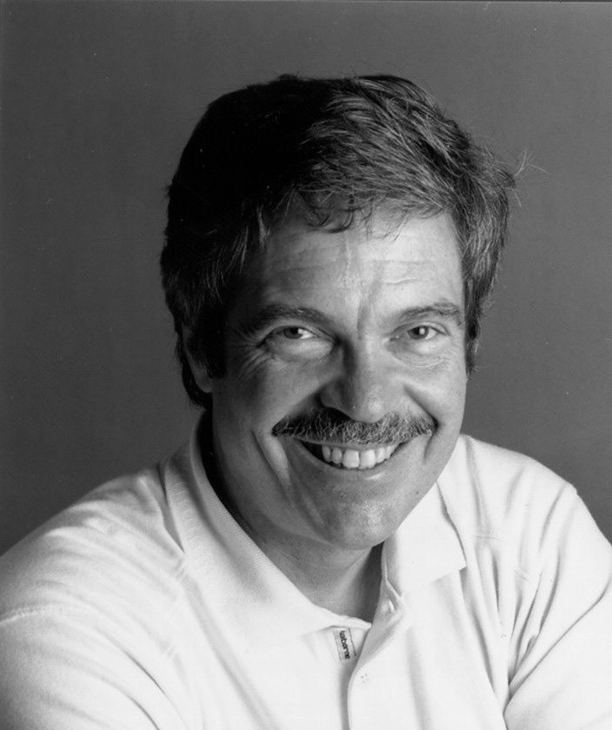







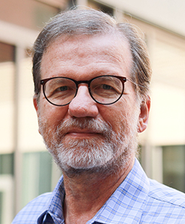


Contributors
I couldn't have created this course without the hours of explanations/content/feedback from the following folks:
Alan Kay
Angelina Lue
Devan Dutta
James Wu
Kevin Tan
Kyle Chui
Maggie Li
Matthew Wang
Paul Eggert
Timothy Gu
Todd Millstein

Slide 5
Guess what?
I love Comic Sans soooo much...
I'm gonna use it for 131 as well!
😂
OK, just kidding... We'll use Corbel!

Slide 6

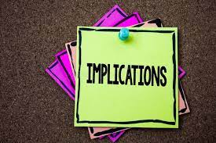
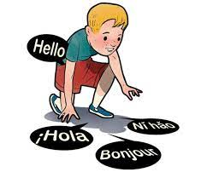


What's CS131 About?
Languages come and go, but they're all built upon a common set 0f paradigms and building-blocks.
Our goal in CS131 is to learn these paradigms and building-blocks, understanding the implications of each.
This will enable you to pick up new languages fast, select the best language for a problem, and even invent your own language!
Notes:
Once we understand the building-blocks, it's easy to take a new language and grok exactly how it works.
This quarter, we're going to catalog the spectrum of building-blocks that make up literally EVERY language.
Our goal in CS131 is to learn this common set of paradigms and ingredients, understanding the implications of each.
This will give us a deep understanding of how programming languages work, and how to best use them to tackle problems in your work and research.

Slide 7
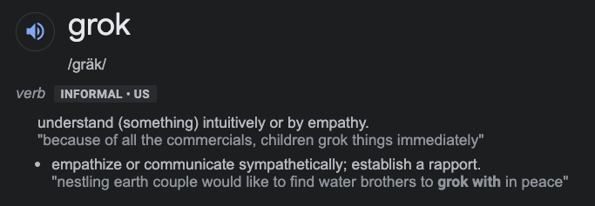
Your Goal by Week 10?
Be able to explain – in your own words - the major language paradigms and building blocks, and their tradeoffs.
Given any new language*, be able to grok how it works and write correct, efficient code in a matter of hours.
Gain fluency in Python and basic proficiency with Haskell and Prolog.
* Except maybe Smalltalk 😂

Slide 8




Assignments and Exams
q’s type is unknown until the actual code runs! It’s type can only be determined ("bound") once a variable is passed in!
10%
30%
25%
35%
CS131 has homework, projects, a midterm and a final exam.
Homework will be graded by effort only – use it to learn.
Our Midterm is on Thursday, Nov 7th from 6 to 8pm!
Projects require you to build and evolve a new language!
Exams will evaluate:
your understanding of key programming language concepts
your ability to analyze languages you've never seen before
your ability to write correct code in our focus languages

Slide 9

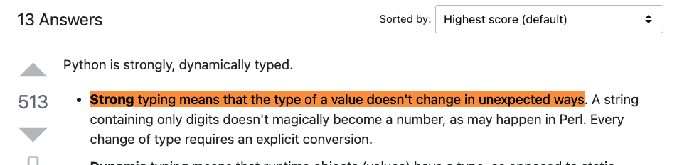



Be Wary of Online Resources
There's still a ton of debate about programming language terms/theory!
So, for this class, please use our slides as a canonical source of information.
If you want more details, limit searches to lecture notes from major universities.
Warning: Stack Overflow, Medium, etc. have lots of incorrect explanations!
Notes:
""strongly typed" language, it is not possible for the programmer to work around the restrictions imposed by the type system." (676 upvotes)
"Strong typing means that the type of a value doesn't change in unexpected ways. " (481 upvotes)
"Strongly typed means that there are restrictions between conversions between types." (31 upvotes)
"Strongly typed means, a variable will not be automatically converted from one type to another." (48 upvotes)

Slide 10

Learning Resources
X
There is no required textbook
(I couldn't find any good ones!)
But... we'll be posting slides and lecture notes, and...
Side-by-side Language Comparisons
Gentle Language Introductions
Learn You a Haskell for Great Good
http://learnyouahaskell.com/
W3 Schools Python Intro
https://www.w3schools.com/python/
Rosetta Code
http://rosettacode.org/
Hyperpolyglot
https://hyperpolyglot.org/
tutorialspoint
https://www.tutorialspoint.com/prolog

Slide 11
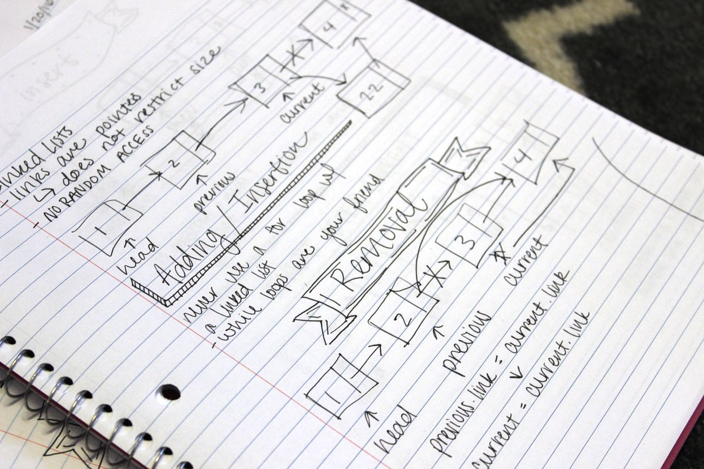
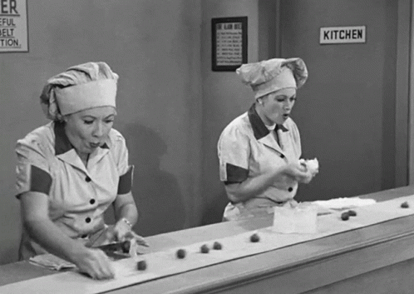

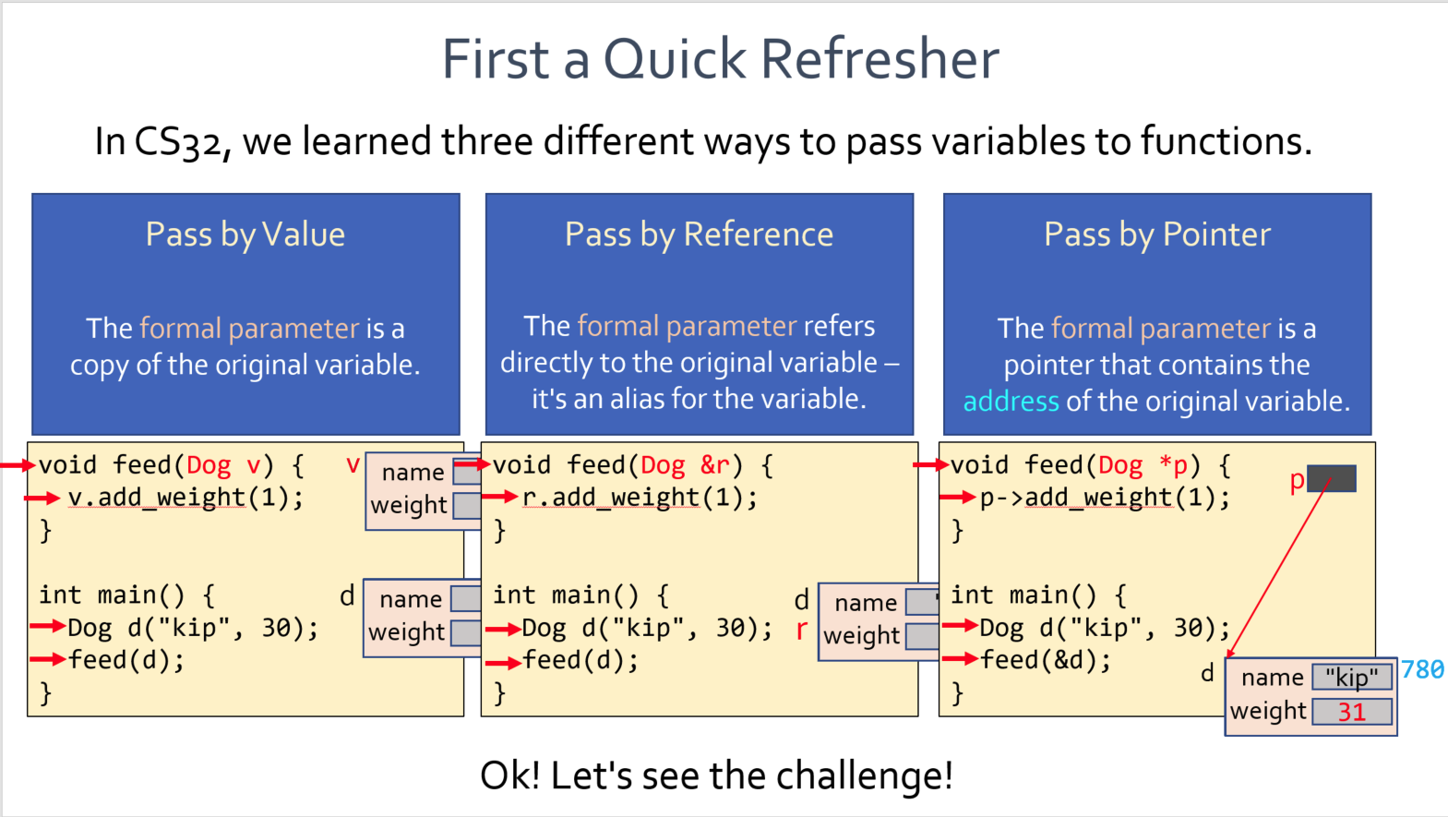

Attention Note Takers!
Many students are used to taking detailed notes during lecture...
If that's you, you may find it difficult to keep up since I show lots of code examples.
Code examples
Suggestion: Download our lecture notes or slides ahead of time and take notes on them...

Slide 12



Our Course Roadmap
Logic Programming
with Prolog
Control Structures
What is functional programming?
Object Oriented Programming
All Things Functions
Data Structures & Types
Deep Dive into Python
Functional Programming with Haskell

Slide 13

Ok, let's go!

Slide 14



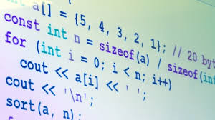
What is a Programming Language?
Thinking time!
A programming language is a structured system of communication designed to express computations in an abstract manner.
When you see this bar, it means:
You have 1 minute to discuss with your neighbor and come up with an answer.
A programming language can be used to define programs that specify the behavior of a computer.
In CS131, we'll be focusing on high-level, "universal" languages like C++ and Python – that is, those capable of implementing pretty much any valid program.
Notes:
Bjarne Stroustrup: One conclusion I drew from the wildly divergent comments on the HOPL-2 paper – and from many other sources – is that there is no agreement on what a programming language really is and what its main purpose is supposed to be. Is a programming lan- guage a tool for instructing machines? A means of communicating between programmers? A vehicle for expressing high-level designs? A notation for algorithms? A way of expressing relationships between concepts? A tool for experimentation? A means of controlling computerized devices? My view is that a general-purpose programming language must be all of those to serve its diverse set of users. The only thing a language cannot be – and survive – is a mere collection of ‘‘neat’’ features.

Slide 15
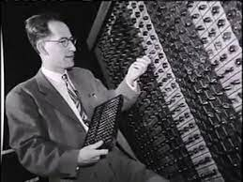
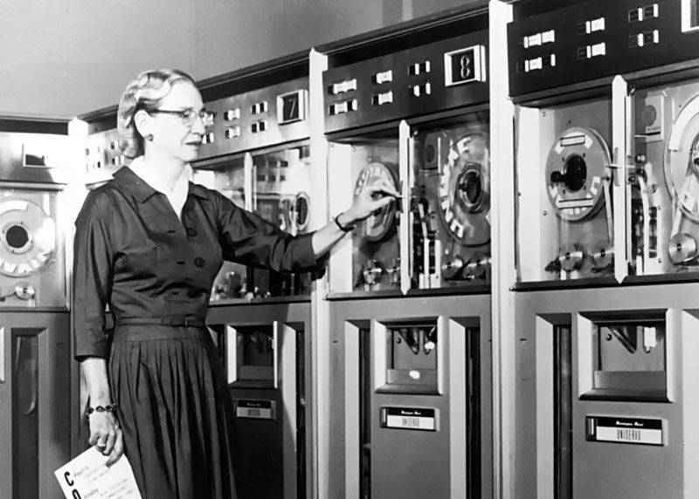
What were the world's first high-level programming languages?
First Interpreted Language: Shortcode
John Mauchly '49
First Compiled Language: A-0
Grace Hopper '51
A program was a set of statements – each a math expression you wanted to compute.
A program was a sequence of subroutine calls with arguments. The compiler converted the program into machine code.
Notes:
Wikipedia: The A-0 system (Arithmetic Language version 0), written by Grace Murray Hopper[1] in 1951 and 1952 for the UNIVAC I, was an early[2] compiler related tool developed for electronic computers.[3] The A-0 functioned more as a loader or linker than the modern notion of a compiler. A program was specified as a sequence of subroutines and its arguments. The subroutines were identified by a numeric code and the arguments to the subroutines were written directly after each subroutine code. The A-0 system converted the specification into machine code that could be fed into the computer a second time to execute the said program.
Grace Brewster Murray Hopper (née Murray; December 9, 1906 – January 1, 1992) was an American computer scientist and United States Navy rear admiral.[1] One of the first programmers of the Harvard Mark I computer, she was a pioneer of computer programming who invented one of the first linkers. Hopper was the first to devise the theory of machine-independent programming languages, and the FLOW-MATIC programming language she created using this theory was later extended to create COBOL, an early high-level programming language still in use today.
Wiki: Short Code was one of the first higher-level languages ever developed for an electronic computer.[1] Unlike machine code, Short Code statements represented mathematic expressions rather than a machine instruction. Also known as an automatic programming, the source code was not compiled but executed through an interpreter to simplify the programming process; the execution time was much slower though.
John William Mauchly (August 30, 1907 – January 8, 1980) was an American physicist who, along with J. Presper Eckert, designed ENIAC, the first general-purpose electronic digital computer, as well as EDVAC, BINAC and UNIVAC I, the first commercial computer made in the United States.

Slide 16
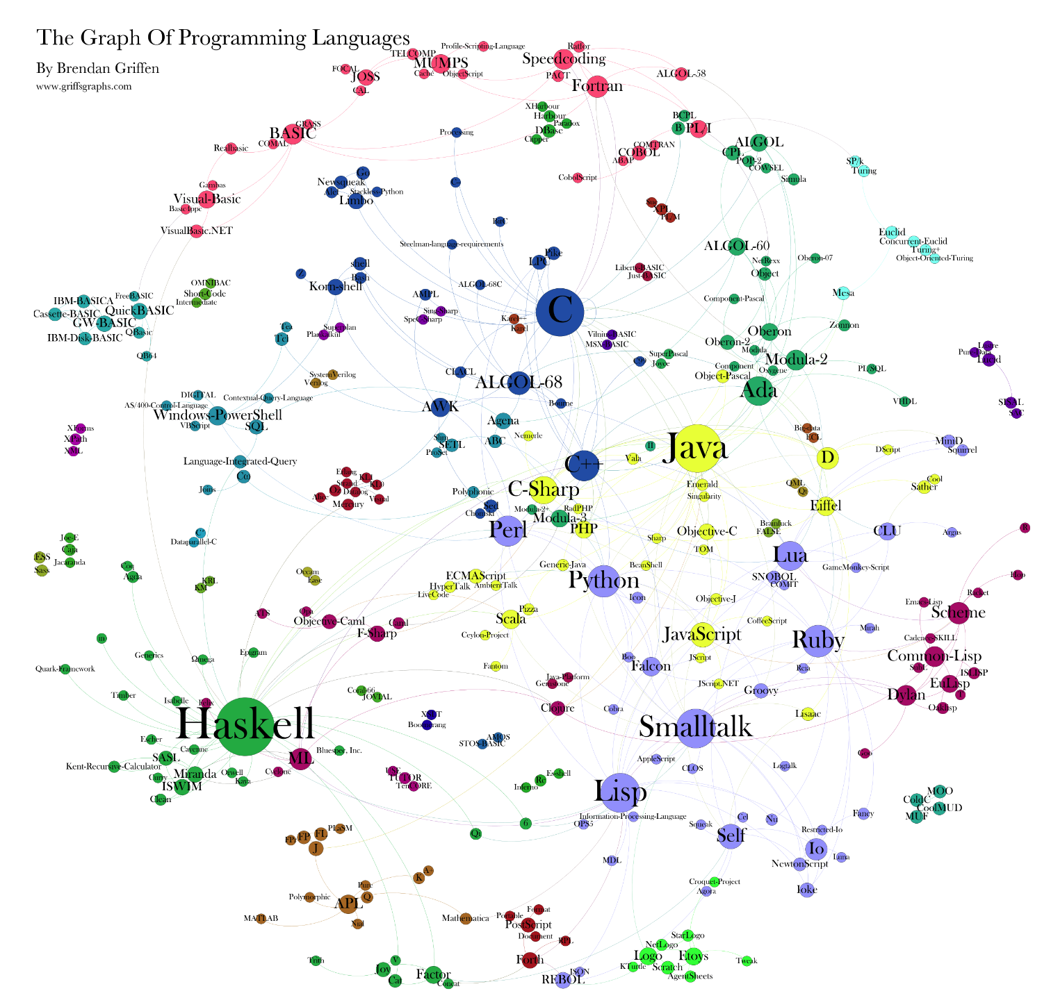
How many different languages exist?
Wikipedia lists 687 different programming languages!
But there are thousands!
Here's a nice visualization showing how interconnected they are!

Slide 17

Why So Many Languages?
Each language is designed to address a particular category of problem, research area, or business domain.
JavaScript was designed for front-end use cases
Simula was developed to build simulations
SQL was designed to query databases
There are also thousands of Domain-Specific Languages (DSLs) that folks have designed to accelerate problem-solving for specific use cases!

Slide 18

How much can a language's design impact problem-solving speed?
Let's find out!

Slide 19
Challenge: How Small is the Smallest Spell Checker?
Given an array of sentences and an array holding an English dictionary, what's the minimum number of lines of code it would take to build a spell checker?
Assume standard sentence delimiters:
comma, period, space, ...
You can choose any language you like!
results = spell_check(s, d);
// results should hold: “admyt” and “lyt”
s
“I must admyt, it is lit”
“So LYT... I can't take it!”
Thinking time!
"Lyt; AdMyT it!"
Answer: 3 lines!
d
”a”
Assume the dictionary is all lower case and in alphabetical order.
# Python spell checker using list comprehensions
import re
def spell_check(s, d):
return {w for w in [w for ln in s for w in re.split(r'[. ,!;"]',ln)]
if w.lower() not in d and w != ''}
“aardvark”
...
“zygote”
“zyther”

Slide 20
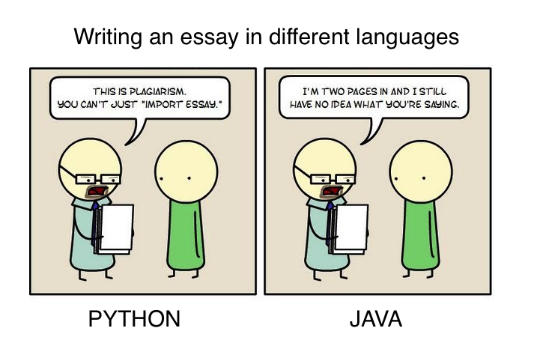

Slide 21

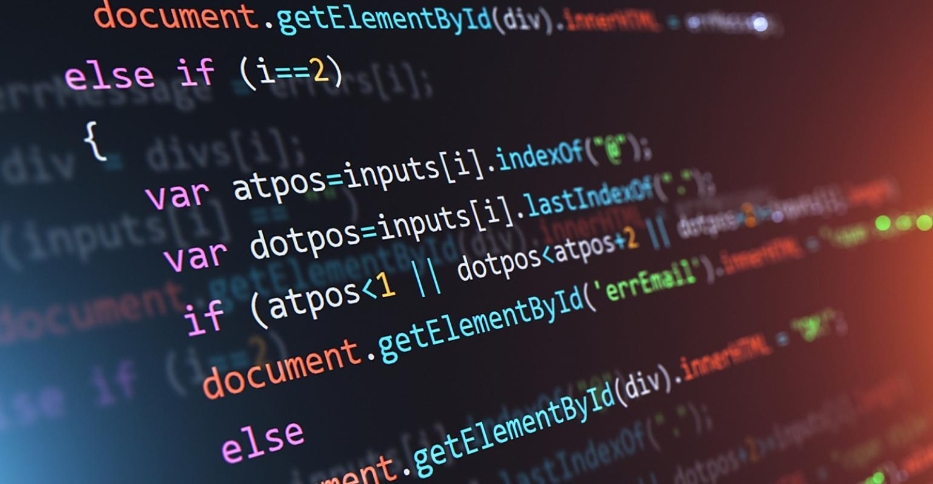
Programming and Starbucks?!?!
&

Slide 22



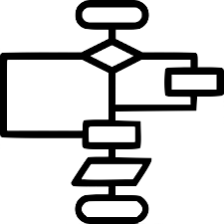
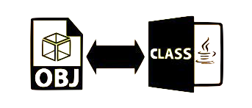

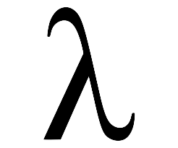
Programming Languages are Like Starbucks Drinks
q’s type is unknown until the actual code runs! It’s type can only be determined ("bound") once a variable is passed in!
Just as we have different classes of drinks...
Coffee Drinks
Hot Chocolate
Teas
Ciders
There are different programming language paradigms:
Imperative
Object Oriented
Functional
Logic

Slide 23
The Major Language Paradigms
And just like coffee drinks, many languages are hybrids!
This quarter, we're going to learn all of the major language paradigms!
C
Smalltalk
Imperative Languages
What you're used to - programs are a made up of statements, loops, and mutable variables.
int a = 0; while (a++ < 100)
cout << a << endl;
OOP Languages
Programs are organized into classes and objects which send messages, e.g., obj.msg(x), to each other to get things done.
class Dog { ... };
C++
Scala
Haskell
Prolog
Functional Languages
Programs are made up of math-like functions. No statements or iteration, only expressions, functions, constants and recursion!
f(n) = if n>0 then n*f(n-1)
else 1
Logic Languages
Programs define a set of facts, e.g.:
like(dogs, meat), category(beef, meat).
Programs also define rules:
likes(A,C): if like(A,B) and category(C, B)
You then query: likes(dogs, beef)?
Notes:
likes(Pet, Thing) <= kindof(Pet, Animal) and likes(Animal, Thing).
likes(dog, bone).
likes(dog, walks).
kindof(fido, dog).
? likes(fido, bone).
Programs are created from "pure" functions – NO variables/iteration! Just constants and recursion!

Slide 24
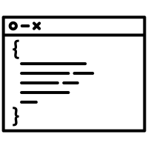
Programming Languages are Like Starbucks Drinks
Coffee Choices
Coffee: light, medium, dark-roast
Starbucks lets you customize coffee across key dimensions...
Milk: 2%, skim, whole, soy, almond, oat
Flavoring: chocolate, caramel, vanilla
Sweetener: sugar, Splenda, stevia
...
For instance, C++ made the following design choices...
But Python made a totally different set of choices!
Language Choices
Similarly, each programming language makes choices across dozens of dimensions.
Type checking: static typing, dynamic typing
Parameter passing: by-value, by-reference, by-pointer, by-object reference, by-name
Scoping: lexical scoping, dynamic scoping
Memory management: manual, automatic
...
Notes:
Similarly, each programming language is the result of dozens of choices.

Slide 25
Language Dimensions: More Examples
Pro: Detects typing bugs at compile time, when they're easy to fix
Con: More verbose code
Pro: Faster dev, simpler code
Con: Less readable code, may detect errors only at runtime
All variables need to be declared before they're used.
A variable can be assigned without any prior declaration.
vs.
int a; // variable declared first!
a = 5; // then it can be assigned
a = 5 # 1st assignm't creates var
The language will perform some type conversions implicitly.
Pro: Detects bugs more easily
Con: More verbose code
Pro: Makes for simpler code
Con: May hide conversion bugs
The language requires explicit syntax for all type conversions.
vs.
int a = 5;
double b = a; // OK!
int a = 5;
double b = (double)a; // OK
Pro: Faster
Con: Permits nasty memory bugs!
Pro: Catches out-of-bounds bugs
Con: Runtime checks slow execution!
The language performs strict checking of array bounds.
The language allows out-of-bound array accesses.
vs.
int arr[] = new int[10];
cout << arr[10]; // Blocked!
int arr[10];
cout << arr[10]; // Allowed! Eek!

Slide 26
Summarizing Our Learning Approach
q’s type is unknown until the actual code runs! It’s type can only be determined ("bound") once a variable is passed in!
We'll deep-dive into the major paradigms
Imperative
Functional
OOP
Logic
We'll go wide and survey the spectrum of design options
Variable
Scoping
Static
Dynamic
Parameter Passing
...
By-value
By-reference
By-object ref
By-name
By-pointer
Memory Management
Manual
Automatic
...
Typing Approach
Static
Dynamic
Weak
Strong
Gradual

Slide 27

An important skill is the ability to logically deduce which design choices each language has made.
So throughout the quarter, we'll be training ourselves to do this with challenges.
Let's see an example.

Slide 28
First a Quick Refresher
In CS32, we learned three different ways to pass variables to functions.
Pass by Value
Pass by Reference
Pass by Pointer
The formal parameter is a copy of the original variable.
The formal parameter refers directly to the original variable – it's an alias for the variable.
The formal parameter is a pointer that contains the address of the original variable.
v
v
void feed(Dog v) {
v.add_weight(1);
}
int main() {
Dog d("kip", 30);
feed(d);
}
void feed(Dog &r) {
r.add_weight(1);
}
int main() {
Dog d("kip", 30);
feed(d);
}
void feed(Dog *p) {
p->add_weight(1);
}
int main() {
Dog d("kip", 30);
feed(&d);
}
name
"kip"
p
weight
31
d
name
d
name
name
"kip"
name
"kip"
"kip"
r
"kip"
weight
weight
weight
30
weight
30
30
31
780
d
name
780
name
"kip"
"kip"
weight
weight
30
31
Ok! Let's see the challenge!

Slide 29
Classify That Language
That didn't change the original variable's value!
The code below...
prints the following:
Clearly, change_major() successfully changes student1's major.
Reassigning s only changes the local pointer, not the original object!
class Student
... # details hidden
# student goes through life changes
def life_changes(s)
s.change_major('Econ')
# hates life choices, so starts from scratch
s = Student.new('Carence', 'Music')
end
# main program
student1 = Student.new('Carey', 'CompSci')
life_changes(student1)
student1.print_my_details()
Carey's major is Econ.
OK, what about reassigning the parameter to refer to a new object?
So, this language must NOT be passing arguments by reference, or student1's name and major would have changed.
Technically, we call this approach "pass by object reference," but it's just like passing by pointer in C++!
name
'Carence'
How does this language pass parameters?
s
major
'Music'
This changes student1's major.
Let's see how it works!
By value? By reference?
By pointer?
student1
So, this language must NOT be passing arguments by value, or student1's major would still be CompSci.
Thinking time!
name
'Carey'
This is Ruby!
major
'Econ'
'CompSci'

Slide 30

We'll Deep Dive Into Three Languages
Of the thousands of languages, this quarter we'll deep-dive into Haskell, Prolog, and Python.
While you're familiar with imperative programming and OOP (via C++), we need to introduce you to the other major language paradigms.
Haskell is one of the simplest and easiest-to-grok functional languages.
Prolog is one of the few examples of logic languages.
Python is a dynamically-typed language (and its super useful).

Slide 31

Next, let's learn what it means to specify the details of a programming language!
How do you even do that?!

Slide 32
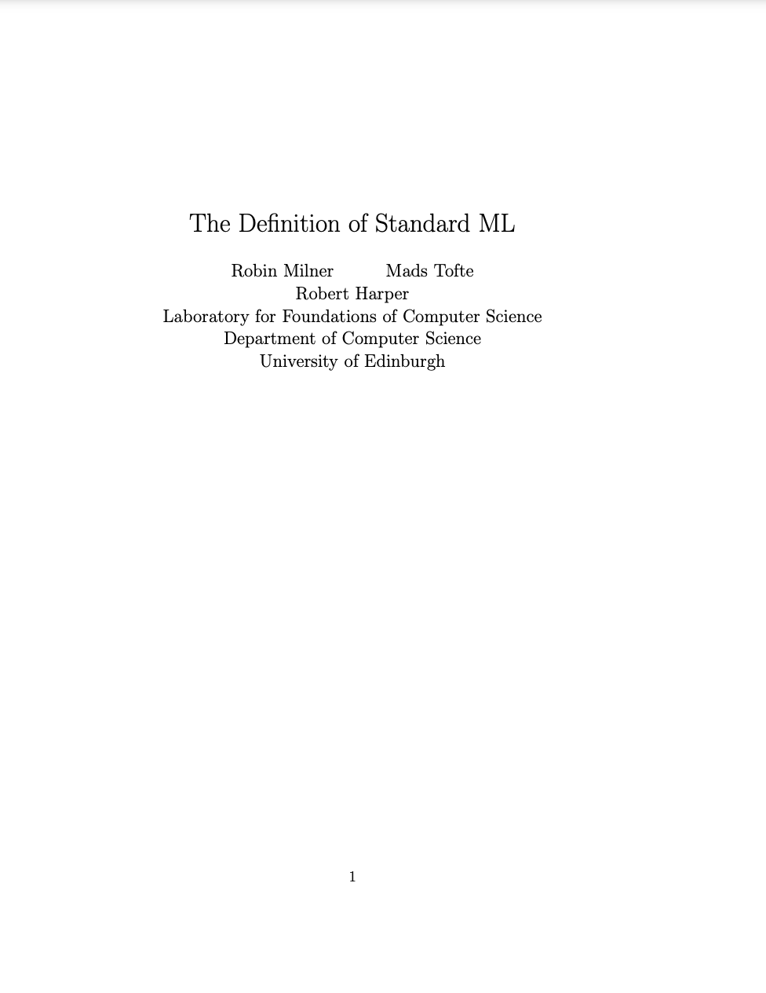
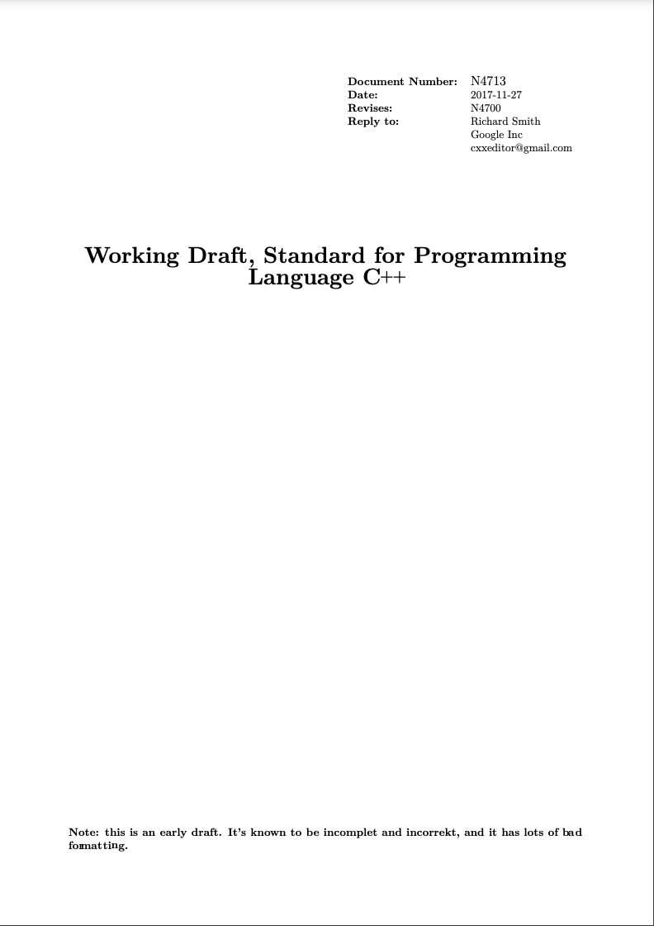

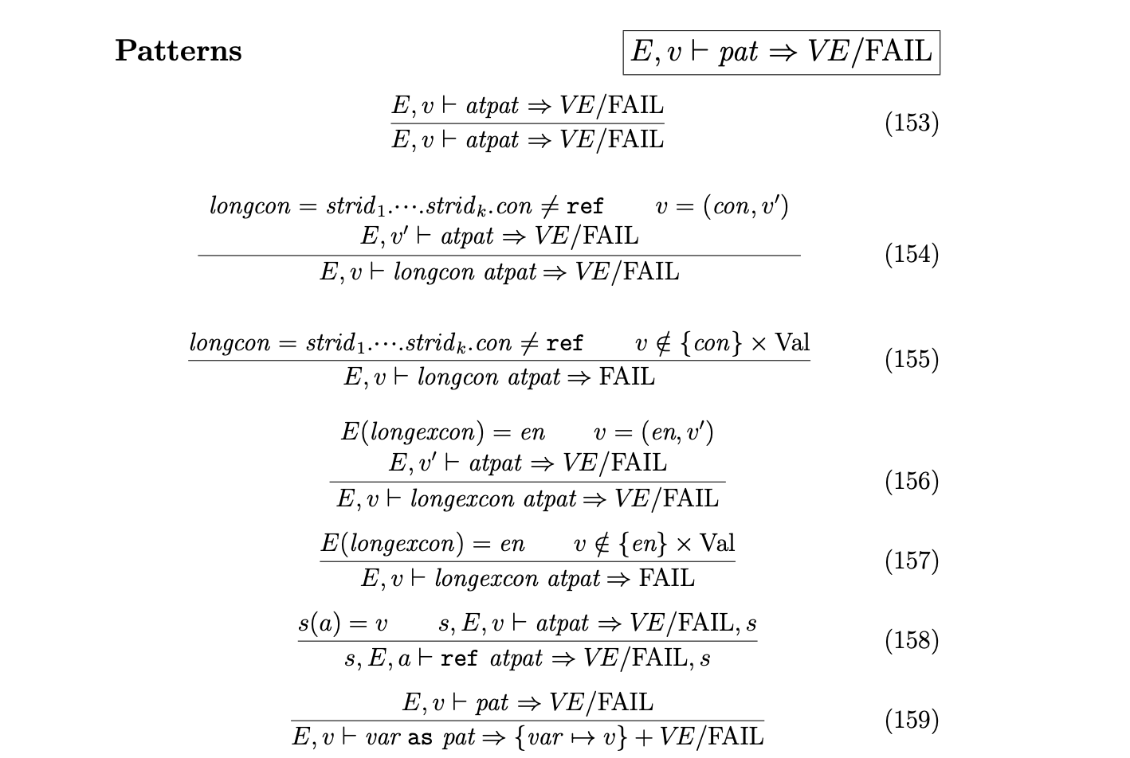
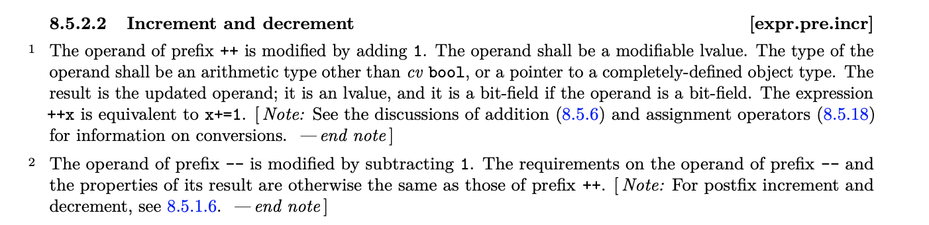
Some language specs, like the one for C++, are written in plain English!!!
What’s needed to specify the details of a Programming Language?
Thinking time!
Other languages, like ML, use a formal mathematical spec to detail semantics!
And some languages have NO written spec at all (like Perl v1-v4)!
Whatever the compiler/ interpreter does is canonical!
A language's semantic spec details areas such as: type checking,
the behavior of operators,
how parameters are passed, etc.
Syntax Spec
Semantic Spec
Most modern languages use an encoding called Extended Backus–Naur Form (EBNF) to define the language's syntax.
A language's syntax spec specifies what sequences of tokens are grammatically allowed.
func: type func_name '(' params ')'
'{' { type var_name ';' } { stmt } '}'
stmt: 'if' '(' expr ')' stmt [ 'else' stmt ]
| 'while' '(' expr ')' stmt
| 'for' '(' [ assg ] ';' [ expr ] ';' [ assg ] ')' stmt
| 'return' [ expr ] ';'
| func_name '(' [expr { ',' expr } ] ')' ';'
| '{' { stmt } '}'
expr: ...
Section 1.31.5.a: Variable Incrementation
...
b = a++;
1. Copy the value of a into b
2. Set a’s value equal to a+1
b = ++a;
1. Set a’s value equal to a+1
2. Copy updated value of a into b
Notes:
Syntax:
In computer science, the syntax of a computer language is the set of rules that defines the combinations of text/visual symbols that are considered to be correctly structured statements or expressions in that language.
First, a lexer turns the linear sequence of characters into a linear sequence of tokens; this is known as "lexical analysis" or "lexing".
Second, the parser turns the linear sequence of tokens into a hierarchical syntax tree (e.g., an Abstract Syntax Tree);
Thirdly, the contextual analysis resolves names (and checks types).
Semantics:
Semantics defines the meaning of syntactically valid strings defined by a specific programming language, detailing the computation involved. It may involve type checking (making sure you don’t try to add a Dog object to a string, for example. The definition may be in english as we see with C++, or a more formal mathematical definition as we see with the LM language.
BNF/EBNF grammar notes: Each of the rules in a context-free grammar is known as a production. The symbols on the left-hand sides of the productions are known as variables, or non- terminals.

Slide 33

Our Tools

Slide 34

What's a Compiler? What's a Linker?
A compiler is a program that translates program source into object modules (which are either machine language, or bytecode targeted at an interpreter).
A linker is a program that combines multiple object modules and libraries into a single executable file or library.
C++ std library
Compiler
GUI library
foo.cpp
foo.o
Compiler
Linker
bar.cpp
bar.o
final_exec
Compiler
bletch.cpp
bletch.o
Notes:
g++ –o final_exec foo.cpp bar.cpp bletch.cpp

Slide 35
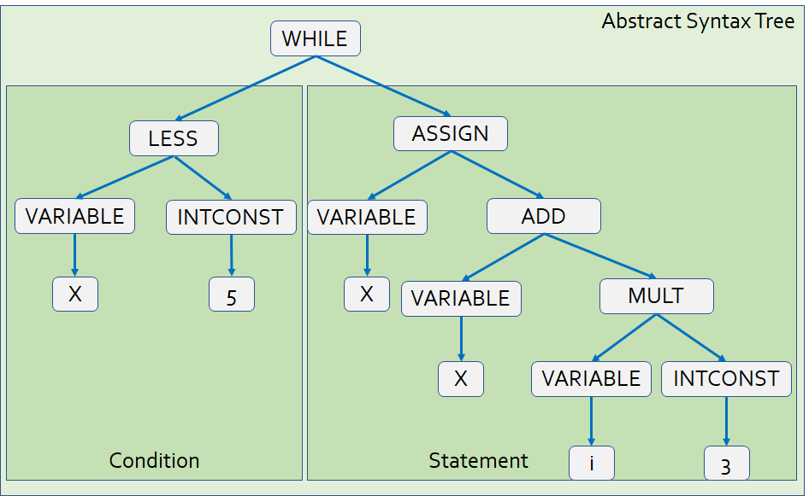

How Does a Compiler Work?
e.g., that x and i are both the same type, and compatible with + and * ops.
func: type func_name '(' params ')'
'{' { type var_name ';' } { stmt } '}'
stmt: 'if' '(' expr ')' stmt [ 'else' stmt ]
| 'while' '(' expr ')' stmt
| 'for' '(' [ assg ] ';' [ expr ] ';' [ assg ] ')' stmt
| 'return' [ expr ] ';'
| func_name '(' [expr { ',' expr } ] ')' ';'
| '{' { stmt } '}'
expr: const | variable | expr '<' expr | ...
The semantic analyzer checks the semantic validity of the tree.
It also updates the tree's nodes with details required for code generation.
The parser uses the language's grammar spec to validate the tokens have a valid syntax.
If the syntax is valid, the parser converts the tokens into a tree that represents program's operations.
The lexical analyzer breaks the source file into a stream of tokens.
Abstract Syntax Tree
WHILE
The IR generator produces an abstract representation of the program – it's totally independent of the original language.
The representation could be a tree structure, or CPU-agnostic instructions.
file.cpp
while(i<5)
x = x + i*3;
Condition
Statement
Compiler workflow
The code generator converts the IR to either machine code or bytecode output.
LESS
ASSIGN
Bytecode is a binary encoding – like a machine language, but not for a real CPU.
It is processed by an interpreter or just-in-time (JIT) compiler.
Abstract Syntax Tree
Source File
Lexical Analyzer
Lexical Units
Parser
Semantic Analyzer
VARIABLE
INTCONST
VARIABLE
ADD
i
while,(,i,<,5,),x,=,x,+,i,*,3
5
X
VARIABLE
MULT
Machine code or bytecode
Code Generator
Intermediate Representation Generator
Intermediate
representation
X
Annotated
Parse Tree
VARIABLE
INTCONST
The output is an annotated tree, with type and other info added to the nodes of the tree.
load i
load_constant 5
less_than
jump_if_zero L1
...
boolean
i
3
integer
55 48 89 e5 c7 45 fc 05 00 00 00 6b 45 fc 03 89 45 f8
integer
integer
integer
integer
integer
Notes:
A context-free grammar is said to define the syntax of the language; parsing istherefore known as syntactic analysis. Parsing organizes tokens into a parse tree that represents higher-level con- structs in terms of their constituents. The ways in which these constituents com- bine are defined by a set of potentially recursive rules known as a context-free grammar. In the process of scanning and parsing, the compiler checks to see that all of the program’s tokens are well formed and that the sequence of tokens conforms to the syntax defined by the context-free grammar.
Semantic analysis is the discovery of meaning in a program. The semantic analysis phase of compilation recognizes when multiple occurrences of the same identifier are meant to refer to the same program entity, and ensures that the uses are consistent. In most languages the semantic analyzer tracks the types of both identifiers and expressions, both to verify consistent usage and to guide the generation of code in later phases. To assist in its work, the semantic analyzer typically builds and maintains a symbol table data structure that maps each identifier to the information known about it. Among other things, this information includes the identifier’s type, in- ternal structure (if any), and scope (the portion of the program in which it is valid).Using the symbol table, the semantic analyzer enforces a large variety of rules that are not captured by the hierarchical structure of the context-free grammar and the parse tree. For example, it checks to make sure that􏰍 Every identifier is declared before it is used.􏰍 No identifier is used in an inappropriate context (calling an integer as a sub- routine, adding a string to an integer, referencing a field of the wrong type of record, etc.).􏰍 Subroutine calls provide the correct number and types of arguments.
Of course, not all semantic rules can be checked at compile time. Those that can are referred to as the static semantics of the language. Those that must be checked at run time are referred to as the dynamic semantics of the language.
A parse tree is sometimes known as a concrete syntax tree, because it demon- strates, completely and concretely, how a particular sequence of tokens can be derived under the rules of the context-free grammar. Once we know that a token sequence is valid, however, much of the information in the parse tree is irrele- vant to further phases of compilation. In the process of checking static semantic rules, the semantic analyzer typically transforms the parse tree into an abstract syntax tree (otherwise known as an AST, or simply a syntax tree) by removing most of the “artificial” nodes in the tree’s interior. The semantic analyzer also annotates the remaining nodes with useful information, such as pointers from identifiers to their symbol table entries. The annotations attached to a particular node are known as its attributes. Using the symbol table, the semantic analyzer enforces a large variety of rules that are not captured by the hierarchical structure of the context-free grammar and the parse tree. For example, it checks to make sure that􏰍 Every identifier is declared before it is used.􏰍 No identifier is used in an inappropriate context (calling an integer as a sub- routine, adding a string to an integer, referencing a field of the wrong type of record, etc.).􏰍 Subroutine calls provide the correct number and types of arguments.
We produce an intermediate code representation from the annotated parse tree that can be optimized and easily converted to one of many machine languages. It's a neutral encoding like:
^{load b}
^{load c}
^{add b + c}
^{store a}
Which is agnostic of any particular machine language, but
The code generation phase of a compiler translates the intermediate form into the target language. Given the information contained in the syntax tree, gen- erating correct code is usually not a difficult task

Slide 36
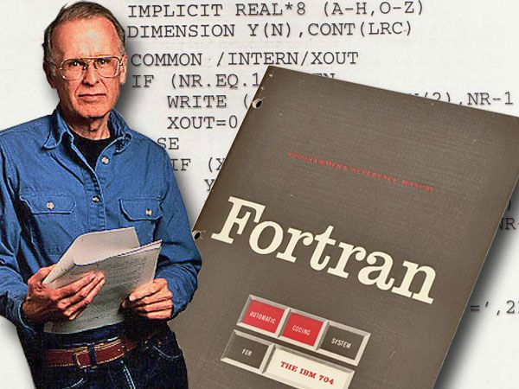
For Funzies
What was the world's first mainstream compiler (for Fortran) written in?
Answer: Assembly language.
Makes sense, right? What else would it be written in?
John Backus
Notes:
g++ –o final_exec foo.cpp bar.cpp bletch.cpp

Slide 37

For Funzies, Part 2
What language are most C++ compilers written in?
Answer: C++?!?!? Through a process called "bootstrapping"
You can write a C++ compiler in C++.
Now we have a working C++ compiler!
// C++ compiler in C++!
class Compiler {
public:
Compiler();
void compile();
};
// C++ compiler in C
struct Compiler
{ ... };
void init(Compiler& c)
void compile(Compiler& c);
C Compiler
c++-to-c-translator.c
c++-to-c-translator.exe
c++-to-c-translator.exe
C Compiler
Once you have a working translator...
c++-compiler.cpp
c++-compiler.c
c++compiler.exe
First you build a C++ to C translator... in some existing language like C.
c++compiler.exe
c++-compiler.cpp
c++compiler.exe

Slide 38
What's an Interpreter?
An interpreter is a program that directly executes program statements, without requiring them to first be compiled into machine language.
How does an interpreter work?
Load source file into RAM
For instance:
Create a variable to track what line of the program we're going to run next.
Create a data structure to track the current value of each variable in the program.
For instance:
Create a new variable
Update a variable's value
Print something to the screen
Initialize data structures needed by the interpreter
Yes
Program finished running?
Exit interpreter
No – still running!
Fetch next statement to run
Interpret current statement and update the program's state
Advanced to next statement

Slide 39
What's an Interpreter?
An interpreter is a program that directly executes program statements, without requiring them to first be compiled into machine language.
Ok, let's build an interpreter for a simple programming language!
Consider the following simple program in our new language which:
initializes a variable called x to 10,
adds 20 to the variable,
prints the value of x,
and finally terminates.
set x 10
add x 20
print x
end

Slide 40
An Interpreter In One Slide!
We'll need to track what line number of our program we're going to run next.
We also need a variable to track whether our program has finished running.
// split() converts "add x 20" to a vector: {"add","x","20"}
vector<string> split(const string& line) { ... }
void interpret(const vector<string>& program) {
int cur_line = 0;
bool terminated = false;
map<string, int> variable_to_value;
while (!terminated) {
vector<string> tokens = split(program[cur_line]);
if (tokens[0] == "end")
terminated = true;
else if (tokens[0] == "set")
variable_to_value[tokens[1]] = stoi(tokens[2]);
else if (tokens[0] == "add")
variable_to_value[tokens[1]] += stoi(tokens[2]);
else if (tokens[0] == "print")
cout << variable_to_value[tokens[1]] << endl;
++cur_line;
}
}
Let's assume we have a function that can split a string up into its parts.
Let's use a map to associate each variable name, e.g., x, with its current value, e.g., 10.
Let's define an interpreter in a single function!
First we'll parse our statement into separate tokens:
"set x 10" → {"set","x","10"}
which causes execution to terminate.
Here's how we'll use it...
We'll start executing at line 0.
stoi() converts a string to an integer.
While our program hasn't terminated itself, keep executing the next statement.
OK, let's see the details!
If the statement is "set", we associate the specified variable name with the value.
If the statement is "add", we update the variable's value by adding the specified amount.
If the statement is "end", we set our terminated variable to true...
If the statement is "print", we get the variable's value out of our map and print it.
"x"
10
int main() {
vector<string> program =
{"set x 10",
"add x 20",
"print x",
"end"};
interpret(program); // 30
}
Finally, we advance to the next line in our program.

Slide 41


Interpreters are Soooo Cool
that you'll be building your own
Our four class projects require you to build an interpreter for a new programming language!
And as we learn new language concepts, you'll add them to your interpreter!
Giving you a deep, hands-on understanding.

Slide 42

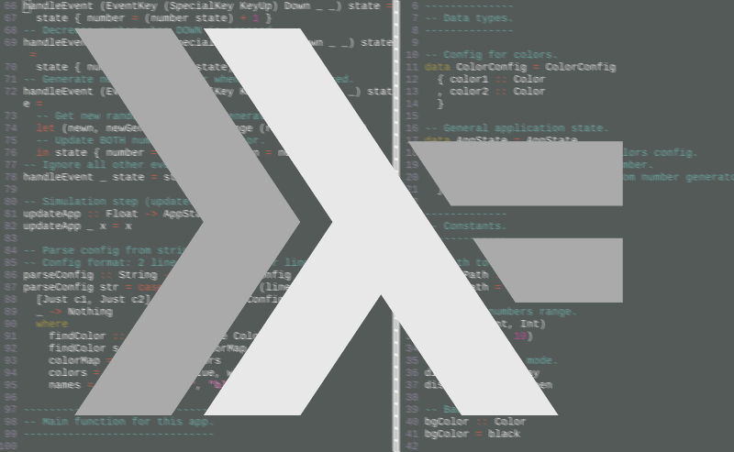

A Few Final Things...
CS131 HW
Your first homework will be posted Wednesday of this week on Gradescope.
Until then, please install the Haskell compiler and Python 3.x interpreter.

Slide 43




A Few Final Things...
CS131 is a notoriously difficult class.
So ask questions...
Stop me if something's unclear...
Don't be afraid to ask for help.
Our goal is not just to cover the material, but for you to deeply understand it and have fun in the process.

Slide 44
Onward to Functional Programming With Haskell!

Slide 45
Appendix

Slide 46

Syntax or Semantic Error?
Which errors will be detected by the parser vs. the semantic analyzer?
Detected by the Parser
Detected here?
Detected by the Semantic Analyzer
Detected here?
Compiler workflow
Source File
Lexical Analyzer
Lexical Units
Parser
Abstract Syntax Tree
Semantic Analyzer
Machine code or bytecode
Code Generator
Intermediate Representation Generator
Intermediate
representation
Annotated
Parse Tree
int main() {
cout << undefined_var;
}
string s;
if (s != 10)
cout << "yeah!";
void foo(int a) { ... }
...
foo(10,20);
vodi bar(float x) { ... }
...
bar(10);
int poop;
cout << poop;
int burp = 5
cout << burp
while (* < 10)
cout << "woot!";
int pee = 5;
cout >> pee;
Notes:
g++ –o final_exec foo.cpp bar.cpp bletch.cpp

Slide 47
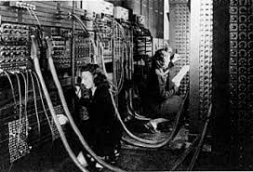
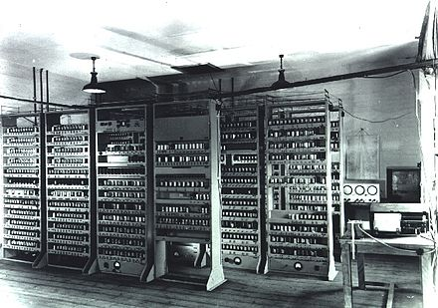

An Early History of Modern Languages
Machine Language
A program is a sequence of numbers which represent instructions, e.g., (0x6b=multiply); the instructions are directly interpreted by the CPU.
55 48 89 e5 c7 45 fc 05 00 00 00 6b 45 fc
03 89 45 f8
Assembly Language
A program is a sequence of barely human-readable operations and operands ("add eax, 5") which have a 1-to-1 correspondence with machine language instructions.
pushq %rbp
movq %rsp, %rbp
movl $5, -4(%rbp)
imull $3, -4(%rbp), %eax
movl %eax, -8(%rbp)
ENIAC '40s
ESDAC '49
They're hard to read!
They're not portable to other CPUs!
Challenge: What are the downsides of machine and assembly languages?
Development is super slow
They're error-prone!
There's no error checking!
Thinking time!

Slide 48

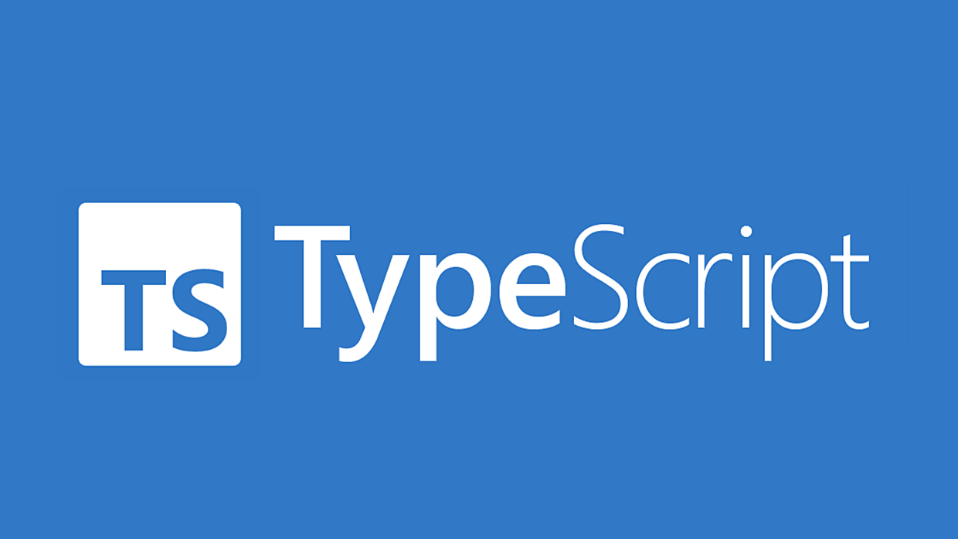





What's a Transpiler?
A transpiler is a program that converts source code from one language into another with the same level of abstraction.
Why/when would we want to do that??
Thinking time!
Enable migration to a "safer" version of a language, yet ensure compatibility with existing platforms
Support a new language's syntax before you have a full compiler for it
CFront
transpiler
foo.ts
foo.js
foo.cpp
foo.c
transpiler
Typescript is like a strict version of Javascript – it greatly reduces bugs!
Stroustrup's first C++ "compiler" was really a transpiler that generated C code!
Compiler
OK, now let's see a transpiler in one slide!
Notes:
The level of abstraction matters. A compile translates source code in a high-level language like C or C++ into assembly language, which is of a lower-level of abstraction. A transpiler translates between languages of similar abstraction (like C++ to C, or TypeScript to JavaScript). Or Java to C, for that matter.

Slide 49
Language Choices: Your Turn
What other big language design choices can you think of?
Thinking time!
This quarter, we're going to learn all the major language design choices and options for each!

Slide 50



What's CS131 About?
To do this, we'll:
Dive deep into each language paradigm:
Imperative, Functional, OOP, Logic
Go wide, surveying the common building blocks that every language is based on
Be hands-on – you'll be implementing your own programming language from scratch this quarter!
Notes:
Go wide, and survey how different languages chose to tackle key design challenges.

Slide 51
But First... A Throwback to CS33!
Machine Language
A program is a sequence of numbers which represent instructions, e.g., (0x6b=multiply); the instructions are directly interpreted by the CPU.
55 48 89 e5 c7 45 fc 05 00 00 00 6b 45 fc
03 89 45 f8
Assembly Language
A program is a sequence of barely human-readable operations and operands ("add eax, 5") which have a 1-to-1 correspondence with machine language instructions.
pushq %rbp
movq %rsp, %rbp
movl $5, -4(%rbp)
imull $3, -4(%rbp), %eax
movl %eax, -8(%rbp)
ENIAC '40s
ESDAC '49
They're hard to read!
They're not portable to other CPUs!
Challenge: What are the downsides of machine and assembly languages?
Development is super slow
They're error-prone!
There's no error checking!
Thinking time!

Slide 52

What are the benefits of a high-level language over assembly/machine language?
Thinking time!
Programs are easier to understand!
They're portable to many CPUs!
Development is faster
There's more error checking!
Notes:
Faster program development – abstraction of key primitives via simpler syntax (function calls, printing things, arithmetic) makes programs faster to develop
Easier to understand high-level programs intent due to the abstraction.
Portability of a program from one machine to other not afforded by assembly/machine language.

Slide 53
How Does a Compiler Work?
e.g., that x and i are both the same type, and compatible with + and * ops.
func: type func_name '(' params ')'
'{' { type var_name ';' } { stmt } '}'
stmt: 'if' '(' expr ')' stmt [ 'else' stmt ]
| 'while' '(' expr ')' stmt
| 'for' '(' [ assg ] ';' [ expr ] ';' [ assg ] ')' stmt
| 'return' [ expr ] ';'
| func_name '(' [expr { ',' expr } ] ')' ';'
| '{' { stmt } '}'
expr: const | variable | expr '<' expr | ...
The semantic analyzer checks the semantic validity of the tree.
It also updates the tree's nodes with details required for code generation.
The parser uses the language's grammar spec to validate the tokens have a valid syntax.
If the syntax is valid, the parser converts the tokens into a tree that represents program's operations.
The lexical analyzer breaks the source file into a stream of tokens.
Abstract Syntax Tree
WHILE
file.cpp
while(i<5)
x = x + i*3;
Condition
Statement
Compiler workflow
The code generator converts the tree to either machine code or bytecode output.
LESS
ASSIGN
Bytecode is a binary encoding – like a machine language, but not for a real CPU.
It is processed by an interpreter or just-in-time (JIT) compiler.
Abstract Syntax Tree
Source File
Lexical Analyzer
Lexical Units
Parser
Semantic Analyzer
VARIABLE
INTCONST
VARIABLE
ADD
i
5
X
while,(,i,<,5,),x,=,x,+,i,*,3
VARIABLE
MULT
Machine code or bytecode
Code Generator
Annotated
Parse Tree
X
VARIABLE
INTCONST
55 48 89 e5 c7 45 fc 05 00 00 00 6b 45 fc 03 89 45 f8
boolean
The output is an annotated tree, with type and other info added to the nodes of the tree.
i
3
integer
integer
integer
integer
integer
integer
Notes:
A context-free grammar is said to define the syntax of the language; parsing istherefore known as syntactic analysis. Parsing organizes tokens into a parse tree that represents higher-level con- structs in terms of their constituents. The ways in which these constituents com- bine are defined by a set of potentially recursive rules known as a context-free grammar. In the process of scanning and parsing, the compiler checks to see that all of the program’s tokens are well formed and that the sequence of tokens conforms to the syntax defined by the context-free grammar.
Semantic analysis is the discovery of meaning in a program. The semantic analysis phase of compilation recognizes when multiple occurrences of the same identifier are meant to refer to the same program entity, and ensures that the uses are consistent. In most languages the semantic analyzer tracks the types of both identifiers and expressions, both to verify consistent usage and to guide the generation of code in later phases. To assist in its work, the semantic analyzer typically builds and maintains a symbol table data structure that maps each identifier to the information known about it. Among other things, this information includes the identifier’s type, in- ternal structure (if any), and scope (the portion of the program in which it is valid).Using the symbol table, the semantic analyzer enforces a large variety of rules that are not captured by the hierarchical structure of the context-free grammar and the parse tree. For example, it checks to make sure that􏰍 Every identifier is declared before it is used.􏰍 No identifier is used in an inappropriate context (calling an integer as a sub- routine, adding a string to an integer, referencing a field of the wrong type of record, etc.).􏰍 Subroutine calls provide the correct number and types of arguments.
Of course, not all semantic rules can be checked at compile time. Those that can are referred to as the static semantics of the language. Those that must be checked at run time are referred to as the dynamic semantics of the language.
A parse tree is sometimes known as a concrete syntax tree, because it demon- strates, completely and concretely, how a particular sequence of tokens can be derived under the rules of the context-free grammar. Once we know that a token sequence is valid, however, much of the information in the parse tree is irrele- vant to further phases of compilation. In the process of checking static semantic rules, the semantic analyzer typically transforms the parse tree into an abstract syntax tree (otherwise known as an AST, or simply a syntax tree) by removing most of the “artificial” nodes in the tree’s interior. The semantic analyzer also annotates the remaining nodes with useful information, such as pointers from identifiers to their symbol table entries. The annotations attached to a particular node are known as its attributes. Using the symbol table, the semantic analyzer enforces a large variety of rules that are not captured by the hierarchical structure of the context-free grammar and the parse tree. For example, it checks to make sure that􏰍 Every identifier is declared before it is used.􏰍 No identifier is used in an inappropriate context (calling an integer as a sub- routine, adding a string to an integer, referencing a field of the wrong type of record, etc.).􏰍 Subroutine calls provide the correct number and types of arguments.
The code generation phase of a compiler translates the intermediate form into the target language. Given the information contained in the syntax tree, gen- erating correct code is usually not a difficult task

Slide 54
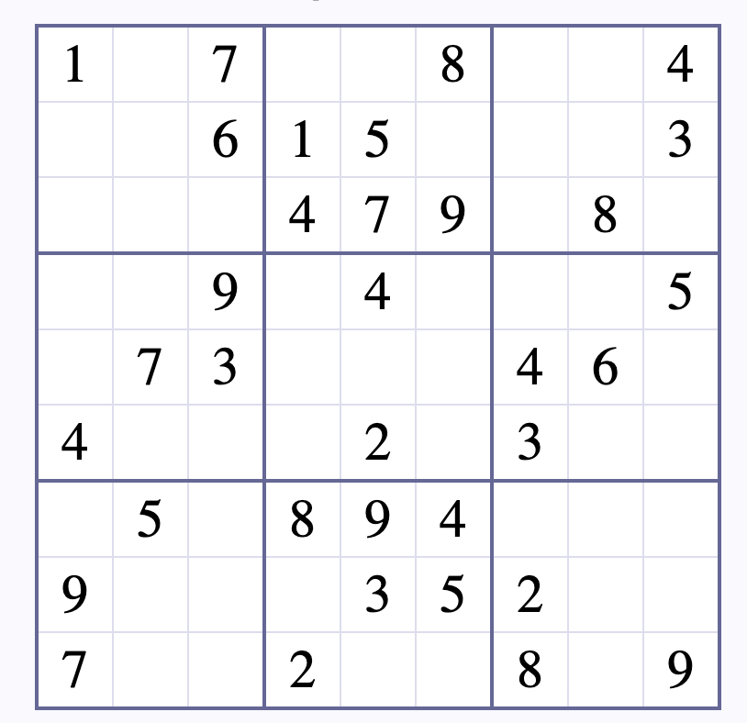
Another Example: Sudoku Solver
How many LoC would it take to build a Sudoku solver in Python?
% Prolog solution for Sudoku in ~15 lines!
sudoku(Rows) :-
length(Rows, 9), maplist(same_length(Rows), Rows),
append(Rows, Vs), Vs ins 1..9,
maplist(all_different, Rows),
transpose(Rows, Columns),
maplist(all_different, Columns),
Rows = [As,Bs,Cs,Ds,Es,Fs,Gs,Hs,Is],
blocks(As, Bs, Cs),
blocks(Ds, Es, Fs),
blocks(Gs, Hs, Is).
blocks([], [], []).
blocks([N1,N2,N3|Ns1], [N4,N5,N6|Ns2], [N7,N8,N9|Ns3]) :-
all_different([N1,N2,N3,N4,N5,N6,N7,N8,N9]),
blocks(Ns1, Ns2, Ns3).
Answer: ~45 lines
Ok, here's the 15-line solution in Prolog!
Clearly, a language can have a massive impact on problem-solving efficiency!
Notes:
LoC means Lines of Code.

Slide 55
Classify That Language
class Student:
def __init__(self, name):
self.name = name
self.debt = 0
def go_to_ucla(self, qtrs):
self.debt += 10000 * qtrs
def my_debt(self):
print(f'{self.name} has ${self.debt} in debt')
# make student glow up
def grow_up(s):
s.go_to_ucla(12)
# erase their debt by creating an alias!
s = Student("Kippy")
# main program
student1 = Student("Carey")
grow_up(student1)
student1.my_debt();
This updates the debt of our original object, through the pointer!
The code to the left...
prints the following:
Clearly, grow_up() successfully changes student1's debt.
Reassigning s only changes the local pointer, not the original object!
Carey has $12000 in debt.
However, reassigning the parameter didn't change the original object!
So, this language must NOT be passing arguments by reference, or student1's name would have changed to Kippy.
Technically, in Python we call this "pass by object reference," but it's just like passing by pointer in C++!
name
'Kippy'
How does this language pass parameters?
s
debt
0
Let's see how it works!
By value? By reference?
By pointer?
student1
So, this language must NOT be passing arguments by value, or student1's debt would stay at zero.
Thinking time!
name
'Carey'
This is Python!
0
debt
12000

Slide 56
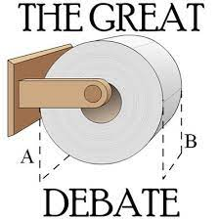
The "Right" Answer
What's better? An O(N∙log₂N) sorting algorithm or a O(N²) version?
What's better? Placing a return type before a function's name/parameters or after? Why?
// C++
double sqrt(double val) { ... }
// Swift
func sqrt(val: Double) -> Double
{ ... }
Thinking time!
Guess what? There's no right answer...
just arguments for/ against each approach!
As we compare programming languages, there often won't be a "right" answer.
So what's important is being able to back up our answer with arguments.

